Slide 1
TWITTER DATA ANALYSIS(EPL): HADOOP2 MAP REDUCE FRAMEWORK
Nadeem yoosuf
Shyam Nair
Umair akhtar
Guide-
Mr. D.K. Chitre

Slide 2
INTRODUCTION
Consider a day in your life. You have to make many choices like: What should I eat for breakfast? Which route should I take to go to college/work? How can I do my work better? How can I optimize my day? What have others done in similar situations?
Your choices define your day. Hence you need to make the correct choice. Analysis of the data at hand will help you make the best decision
Analysis of data uncovers individual characteristics of the subject and these trends and characteristics can be used in all fields of Science
Similarly, in football, we can find out which is the most popular team, most popular player, etc.

Slide 3
Problem Definition
In order to analyse data, we need to choose the site from where we collect data.
Social media sites contain a lot of data in the form of tweets and hashtags. Another added advantage of social media sites is that they encompass the people’s sentiment and their thoughts
So our project, Twitter Data Analysis (EPL) will statistically represent, in the form of graphs, the most popular teams, the trending topics and the recent tweets by most popular users.
Representing data in the correct form is of utmost importance as we want even the common layman to understand.

Slide 4

Objective and Scope
The Project aims to analyze data about the English Premier League (Football) which is obtained from Twitter. Tweets and most popular hashtags are recorded, which would give information such as: Most active users, most popular team, the popularity of those teams in different parts of the world, etc.
The main sections of this project would be:
Content Retrieval: The large amount of data is collected using java Twitter streaming API.
Data Processing: Data collected over a period of time is processed by using parallel and distributed processing software framework developed by Apache Hadoop and using map reduce programming model.

Slide 5
3. Storage: This data is stored in a certain format so as to form key value pair which is needed to feed to mapper in map-reduce programming approach. The data is stored in Hadoop2 Distributed File System.
4. Data Analysis: The output obtained from reducer phase is analysed using a data analysis tool like RStudio in language R.
5. Visualization: Various ongoing trends on social networking sites are aesthetically represented using plotting libraries in R.

Slide 6

MOTIVATION
The motivation for doing this project was mainly an interest in undertaking a challenging project in an interesting area of big data analysis. The opportunity to learn about a new area of computing not covered in lectures was appealing to us.
It would be very interesting to gather and then aggregate the social networking data so as to extract interesting patterns and recent trends from it.
Since Hadoop is a very popular and relatively easy language which is used for processing data, we were excited to work with Hadoop
We will also be introduced to a statistical programming language for the first time: R language

Slide 7
MOTIVATION (cont.)
We also hope that our findings, our research and our product can at least slightly contribute to mankind.
If the main objective of this project is fulfilled, then it would be beneficial to many football fans and other organizations like “OptaStats” who use this information and provide it to football clubs who want better results.
This project can make football more interesting and more appealing for fans to watch

Slide 8
LITERATURE SURVEY
Big Data refers to technologies and initiatives that involve data that is too diverse, fast-changing or massive for conventional technologies, skills and infrastructure to address efficiently. Said differently, the volume, velocity or variety of data is too great.
The volume of data with the speed it is generated makes it difficult for the current computing infrastructure to handle big data. To overcome this drawback, big data processing can be performed through a programming paradigm known as MapReduce.
Big data is seen as a potential huge driver of returns for the next generation of multi-billion-dollar software companies. It represents the fastest-growing market for information systems globally. Analysts believe that the total addressable market is worth US$100 billion (A$102 billion).

Slide 9
Why Big Data?
Growth of Big Data is needed
Increase of storage capacities
Increase of processing power
Availability of data(different data types) – Every day we create 2.5 quintillion bytes of data; 90% of the data in the world today has been created in the last two years alone
Big Data is different as it is automatically generated by a machine (e.g. Sensor embedded in an engine)
It is typically an entirely new source of data (e.g. Uses internet to obtain data)

Slide 10
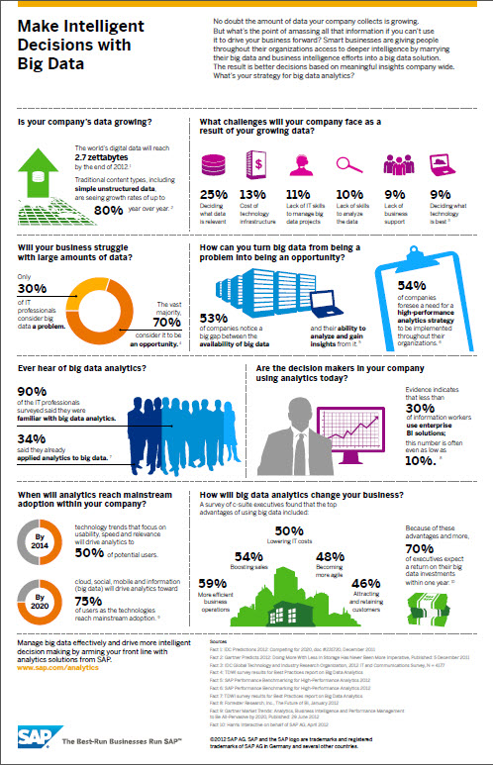

Slide 11
Goals of Big Data
A. Meeting the need for speed
In today’s hypercompetitive business environment, companies not only have to find and analyse the relevant data they need, they must find it quickly.
B. Understanding the data
It takes a lot of understanding to get data in the right shape so that you can use visualization as part of data analysis. For example, if the data comes from social media content, you need to know who the user is in a general sense.
C. Addressing data quality
Data visualization will only prove to be a valuable tool if the data quality is assured.
D. Displaying meaningful results
According to the context, results should be displayed appropriately in a way such that users can understand

Slide 12
Applications of Big Data
Personalized services. With more personal data collected, commercial enterprises are able to provide personalized services adapt to individual preferences.
Internet security. When a network-based attack takes place, historical data on network traffic may allow us to efficiently identify the source and targets of the attack.
Digital humanities. Nowadays many archives are being digitized. For example, Google has scanned millions of books and identified about every word in every one of those books. This produces massive amount of data and enables addressing topics in the humanities
Betterment of Sport: Analyzing the trends and behaviors of certain teams, the owners of those teams can improve based on these results

Slide 13
Implementation
PREREQUISITES:
You have already installed R and are using RStudio.
In order to extract tweets, you will need a Twitter application and hence a Twitter account. If you don’t have a Twitter account, please sign up.
Use your Twitter login ID and password to sign in at Twitter Developers.

Slide 14
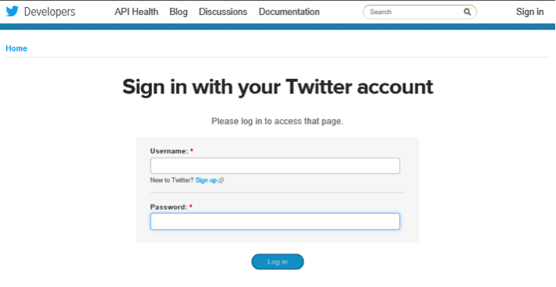
1. To Create Twitter Application
Sign in to the Twitter Account

Slide 15
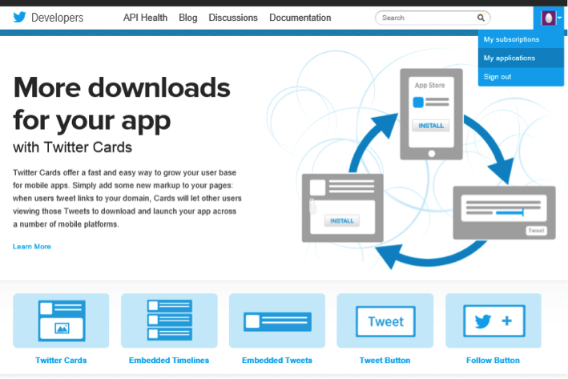
Navigate to My Applications in the upper right hand corner.

Slide 16
c. Create a new application.
d. Fill out the new app form. Names should be unique, i.e., no one else should have used this name for their Twitter app.
Give a brief description of the app.
You can change this later on if needed. Enter your website or blog address.

Slide 17
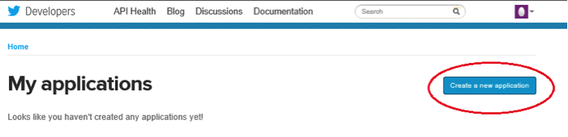
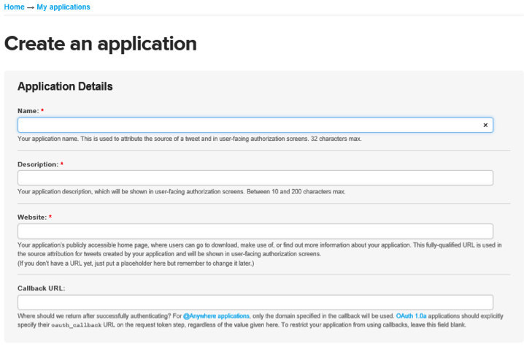

Slide 18
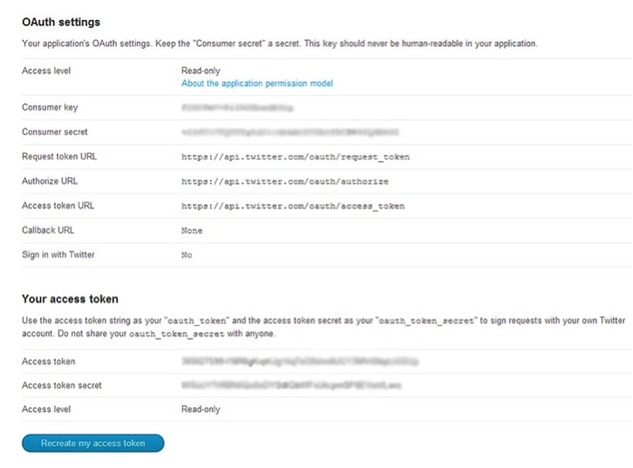
e. Scroll down and click on “Create my access token” button.
f. Note the values of consumer key and consumer secret and keep them handy for future use.

Slide 19
2. INSTALL AND LOAD R PACKAGES
install.packages("twitteR")
install.packages("ROAuth")
library("twitteR")
library("ROAuth")

Slide 20
3. EXTRACT TWEETS
Load “twitter authentication.Rdata” file in your session and run registerTwitterOAuth.
This should return “TRUE” indicating that all is good and we can proceed.
Then we set two variables, one for the search string, which could be a hashtag or user mention, and the second variable is the number of tweets we want to extract for analysis.
load("twitter authentication.Rdata")
registerTwitterOAuth(cred)
search.string <- "#nba"
no.of.tweets <- 100
tweets <- searchTwitter(search.string, n=no.of.tweets, cainfo="cacert.pem", lang="en")
tweets

Slide 21
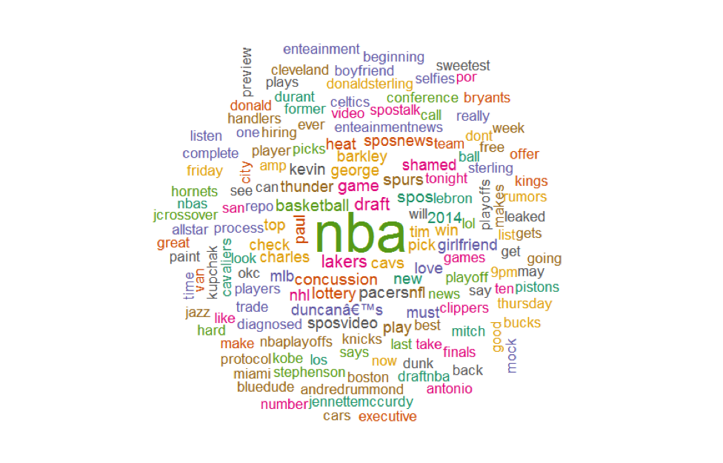
For Example NBA(National Basketball Association)
The tags which we might look out for
The Word cloud of NBA:

Slide 22
4. CLEAN UP TEXT
We have already been authenticated and successfully retrieved the text from the tweets using #nba.
The first step in creating a word cloud is to clean up the text by using lowercase and removing punctuation, usernames, links, etc.
We are using the function gsub to replace unwanted text.
#convert all text to lower case
tweets.text <- tolower(tweets.text)
# Replace blank space (“rt”)
tweets.text <- gsub("rt", "", tweets.text)
# Replace @UserName
tweets.text <- gsub("@\\w+", "", tweets.text)
# Remove punctuation
tweets.text <- gsub("[[:punct:]]", "", tweets.text)
.
.

Slide 23
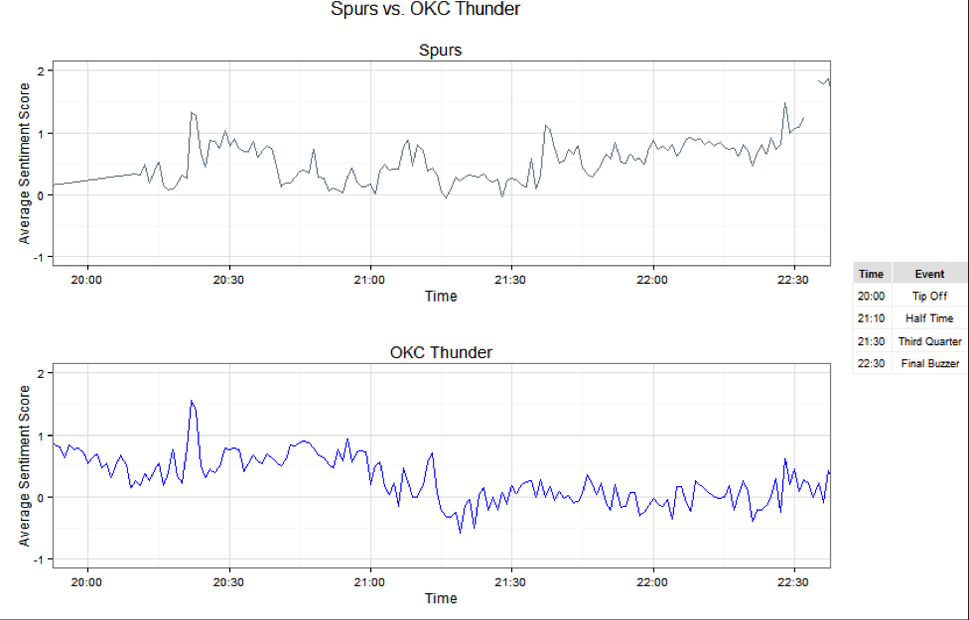
5. CREATE THE GRID
Now that we have extracted and scored the tweets for each team, we want to graph the results. Here we will use a line graph to display the results.
The y-axis displays the average sentiment score of tweets. The x-axis shows the time the tweet was created.
The two plots are arranged on a grid using the gridExtra package. The legend on the side helps map time to game events

Slide 24
Code for Previous Graph Presentation
#plot by time and average score
plot.OKCThunder <- ggplot(OKCThunder.summary, aes(x=created, y=avg))+ geom_line(color='blue')+ scale_x_datetime(limits = c(as.POSIXct(strptime("2014-05-22 20:00", "%Y-%m-%d %H:%M")), as.POSIXct(strptime("2014-05-22 22:30", "%Y-%m-%d %H:%M")))) + labs(title = "OKC Thunder", x = "Time", y = "Average Sentiment Score") + ylim(-1, 2) +theme_bw()
plot.Spurs <- ggplot(Spurs.summary, aes(x=created, y=avg))+ geom_line(color='slategray')+ scale_x_datetime(limits = c(as.POSIXct(strptime("2014-05-22 20:00", "%Y-%m-%d %H:%M")), as.POSIXct(strptime("2014-05-22 22:30", "%Y-%m-%d %H:%M")))) + labs(title = "Spurs", x = "Time", y = "Average Sentiment Score") + ylim(-1, 2) + theme_bw()
#create legend for grid
legendtable <- data.frame(Time = c('20:00', '21:10', '21:30', '22:30'), Event = c("Tip Off","Half Time", "Third Quarter","Final Buzzer"))

Slide 25
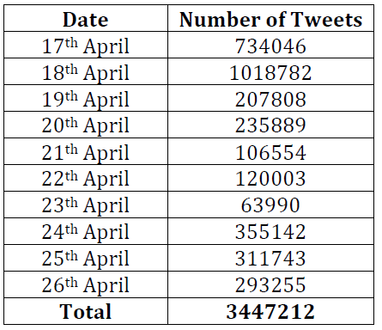
Amount of data collected and details
1. Data is collected for different ranges of dates (day-range , week-range)
2. Total of 300 MB data is collected over the period from 17th April to 26th April.

Slide 26
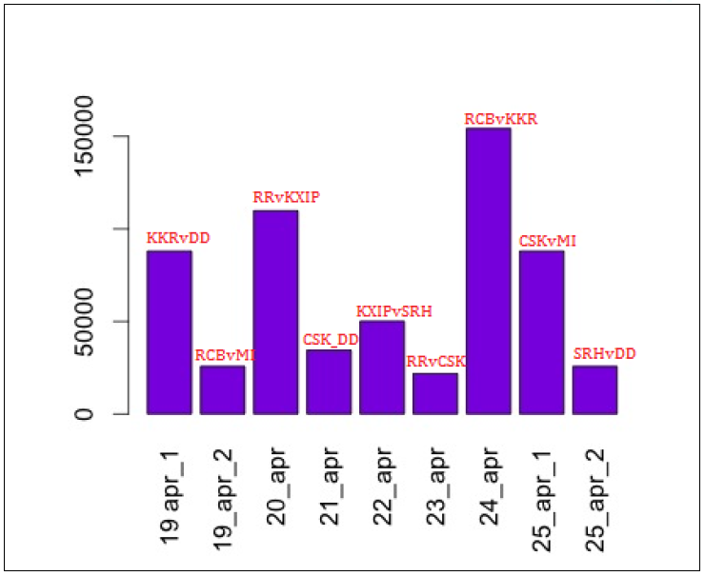
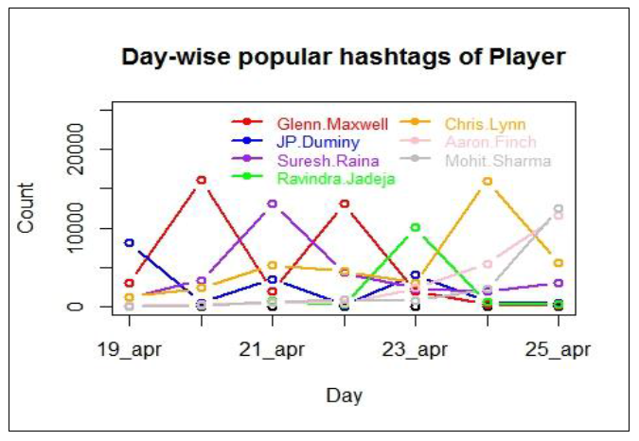
Stats of Teams during period 19Apr to 25 Apr
Players Stats for the same period

Slide 27
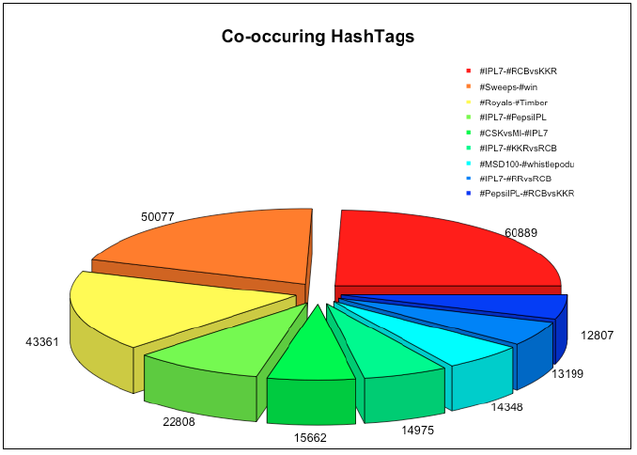
Pie chart displaying hash tags occureances
Hash tags Textplot by day

Slide 28
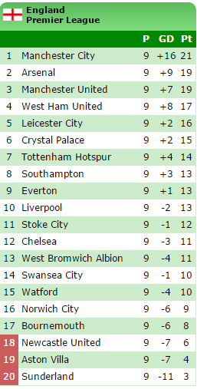
The teams of Barclays Premier League are listed with their present standings

Slide 29
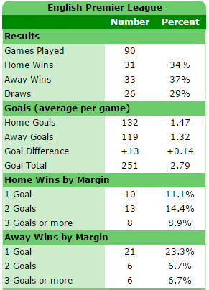
Stats necessary for our display in our dashboard

Slide 30
Feasibility and Analysis

Slide 31
Feasibility
Twitter API: The Streaming API is the real-time sample of the Twitter Firehose. This API is for those developers with data intensive needs. Streaming API allows for large quantities of keywords to be specified and tracked, retrieving geo-tagged tweets from a certain region, or have the public statuses of a user set returned. We used twitter API to get tweet text, date, username, follower count, retweet count. We also used filter query to collect topic specific tweet.
Data aggregator: we collect the data from twitter using Streaming API. Once the data is received, we clean the unwanted details from the tweets and save them in a set of regular files in a designated directory.
Data: Once the data collected we put this data into Hadoop’s /input directory so that map reduce program can read the data from this folder.

Slide 32
Data-Intensive Analysis (MR):
Setup Hadoop 2 for HDFS and Map Reduce infrastructure.
Designing and implementing the various MR workflows to extract various information from the data. (I) simple word count (ii) trends (iii) #tag counts (iv)@xyz counts etc.
Discovery: From the MR implementation we discover different knowledge about most trending words, hash tags, most co-occurring hash tags. The output files are converted into csv and visualization on this data is done in R.
Visualization: We analyse the discovered knowledge in R. We plot various graph to find the most trending words, hash tags. We analyse the data on daily/ weekly basis to find the current trend. Also uploads the result on website

Slide 33
Risk Analysis
Unreliable data
Fake data
Fake account
Hash tags misinterpreted

Slide 34
Analysis & Design

Slide 35
Data Analysis
Data is aggregated from Twitter using java Twitter Streaming API
Tweets for the current trending topic “Indian Premier League” are collected using filter query in Twitter API. Various hash tags for IPL are added as filter while collecting data.
Data is collected for different ranges of dates (day-range ,week-range)
Aggregated raw data is cleansed to some extend before analysing it using Map-Reduce methods.
• Removal of stop words
• Removal of hyperlinks
• Removal of punctuations

Slide 36
The format of collected tweets has following fields:
• Date
• User name
• Follower count of the user
• Tweet text
Each tweet is separated by new line and the above information is separated by a delimiter so that the processing in Map reduce is easy.

Slide 37
CONCLUSION
As we have entered an era of Big Data, processing large volumes of data has never been greater. Through better Big Data analysis tools like Map Reduce over Hadoop and HDFS, guarantees faster advances in many scientific disciplines and improving the profitability and success of many enterprises. MapReduce has received a lot of attentions in many fields, including data mining, information retrieval, image retrieval, machine learning, and pattern recognition. However, as the amount of data that need to be processed grows, many data processing methods have become not suitable or limited.
In this Project we aim to serve a processed twitter tweet database to frontend third party visualization applications. Text analysis focused on processing the tweets to extract information from the raw data of tweet, which can benefit the frontend application in projecting more information to the user, in terms of usability and exploring text-engineered data.

Slide 38
REFERENCES
[1] Hadoop,“PoweredbyHadoop,”http://wiki.apache.org/hadoop/PoweredBy.
[2] Hadoop Tutorial, YahooInc. https://developer.yahoo.com/hadoop/tutorial/index.html
[3] Apache: Apache Hadoop, http://hadoop.apache.org
[4] Hadoop Distributed File System (HDFS), http://hortonworks.com/hadoop/hdfs/
[5] Jianqing Fan1, Fang Han and Han Liu, Challenges of Big Data analysis, National Science Review Advance Access published February, 2014.
[6] Hadoop MapReduce- http://hadooptutorial.wikispaces.com/MapReduce

Slide 39
REFERENCES (continued)
[7] Amazon Simple Storage Service (Amazon S3). http://aws.amazon.com/s3/
[8] Apache Hive, http://hive.apache.org/
[9] Jens Dittrich JorgeArnulfo Quian´eRuiz, Efficient Big Data Processing in Hadoop MapReduce.
[10] Changqing Ji, Yu Li, Wenming Qiu, Uchechukwu Awada, Keqiu Li, Big Data Processing in Cloud Computing Environments, 2012 International Symposium on Pervasive Systems, Algorithms and Networks.
[11] Kyuseok Shim, MapReduce Algorithms for Big Data Analysis.
[12] Jeffrey Dean and Sanjay Ghemawat, MapReduce: Simplified Data Processing on Large Clusters.

Slide 40
REFERENCES (continued)
[13] Apache Giraph Project, http://giraph.apache.org/
[14] Guoping Wang and CheeYong Chan, MultiQuery Optimization in MapReduce Framework
[15] VinayakBorkar, Michael J. Carey, Chen Li, Inside “Big Data Management”: Ogres, Onions, or Parfaits? EDBT/ICDT 2012 Joint Conference Berlin, Germany,2012 ACM 2012, pp 3-14.
[16] OnurSavas, YalinSagduyu, Julia Deng, and Jason Li,Tactical Big Data Analytics: Challenges, Use Cases and Solutions, Big Data Analytics Workshop in conjunction with ACM Sigmetrics 2013,June 21, 2013.
[17] GrzegorzMalewicz, Matthew H. Austern, Aart J. C. Bik, James C.Dehnert, Ilan Horn, NatyLeiser, and GrzegorzCzajkowski,Pregel: A System for Large-Scale Graph Processing, SIGMOD‟10, June 6–11, 2010, pp 135-145.

